Slide 1
My Perimeter, Area and Volume Interactive Notebook
Name
Class
Term 3 Semester 2

Slide 2
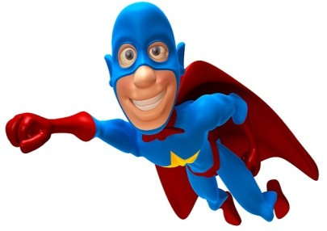
Which ones are you using?
Creative Thinker
Effective Participator
Independent Enquirer
Reflective Learner
Self Manager
Team Worker
Personal Learning and Thinking Skills
LESSON OBJECTIVES
We are learning to:
Be reflective learners on previous learning outcomes. (Which PLT skills?)
Accurately calculate the volume of cylinders.
Always aim high!

Slide 3










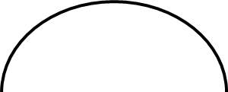
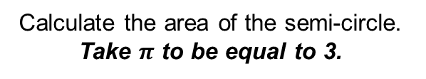
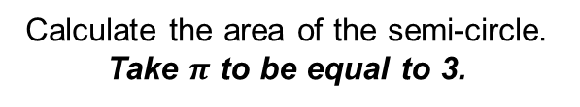






Which ones are you using?
Creative Thinker
Effective Participator
Independent Enquirer
Reflective Learner
Self Manager
Team Worker
STARTER
PLT Skills
TASK
1)
2)
3)
4)
Write down the circumference of a circle formula
Write down the area of a circle formula
10cm
200m
Calculate the area of the circle
Calculate the area of the circle
EXTENSION
1)
2)
2cm
10m
Notes:
3

Slide 4
24
7
30
Date
Volume of a Cylinder
EQ – Describe the process for finding the Volume of a cylinder.
5

Slide 5
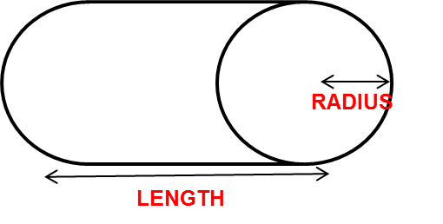




Which ones are you using?
Creative Thinker
Effective Participator
Independent Enquirer
Reflective Learner
Self Manager
Team Worker
PLT Skills
VOLUME OF CYLINDERS
VOLUME OF A CYLINDER = AREA OF CIRCLE X LENGTH
EXAMPLES
1)
2)
16m
18m
6cm
15cm
Calculate the volume of the cylinder
Calculate the volume of the cylinder
x
8
8
x
Volume of a cylinder =
x
6
x
6
15
Volume of a cylinder =
x
x
18
Volume of a cylinder =
Volume of a cylinder =
(1d.p.)
Notes:
5

Slide 6
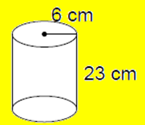
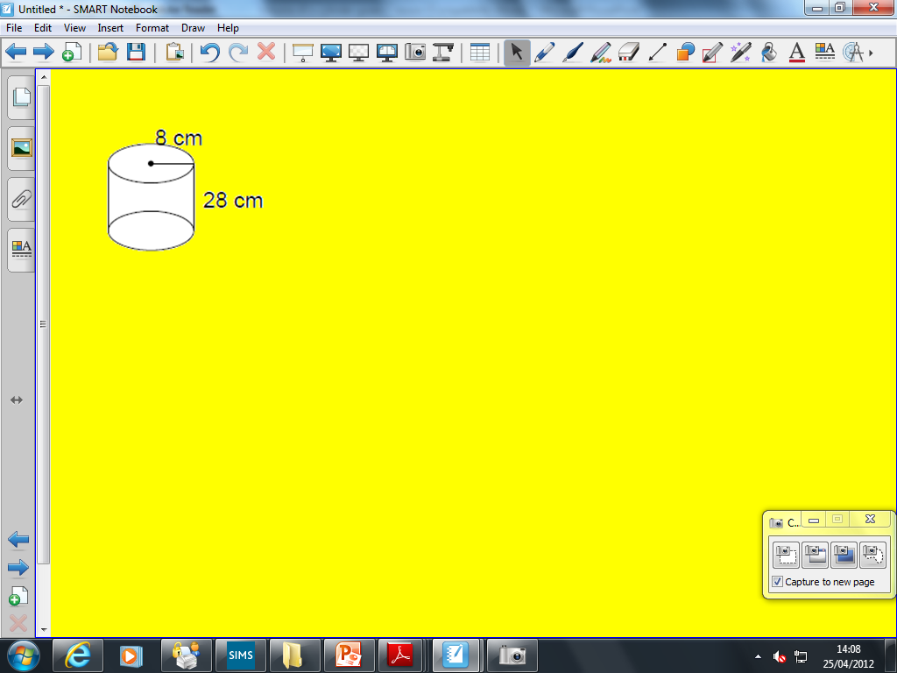
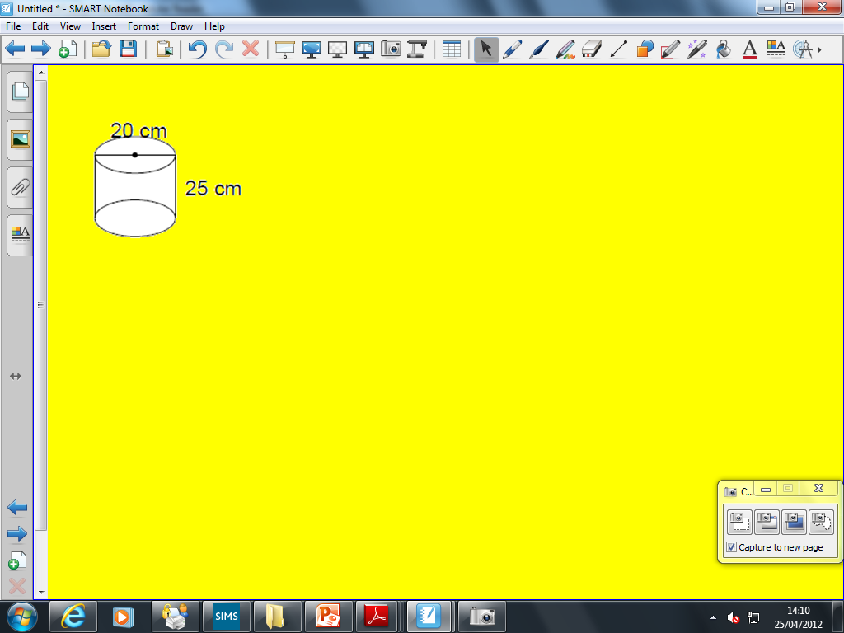



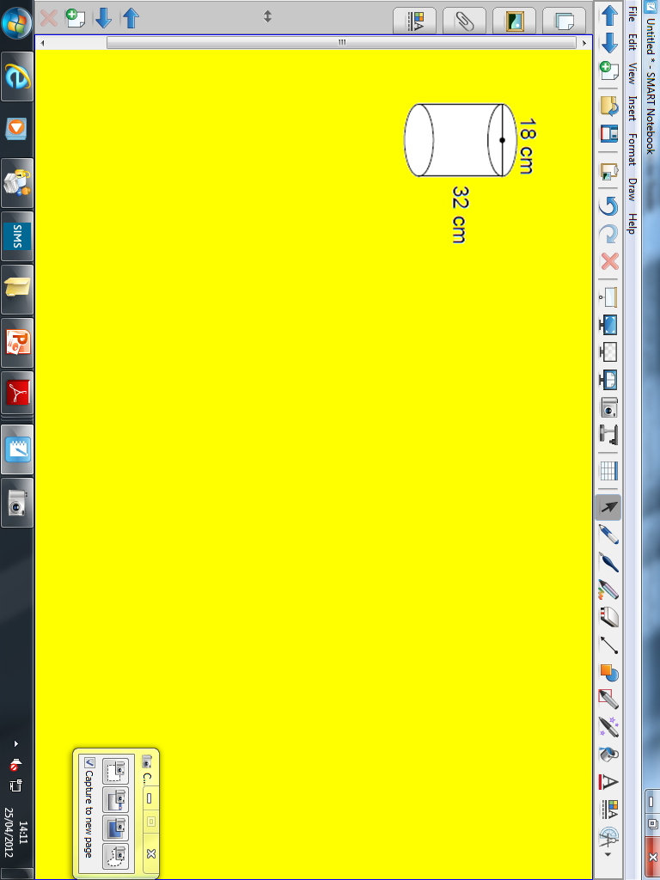

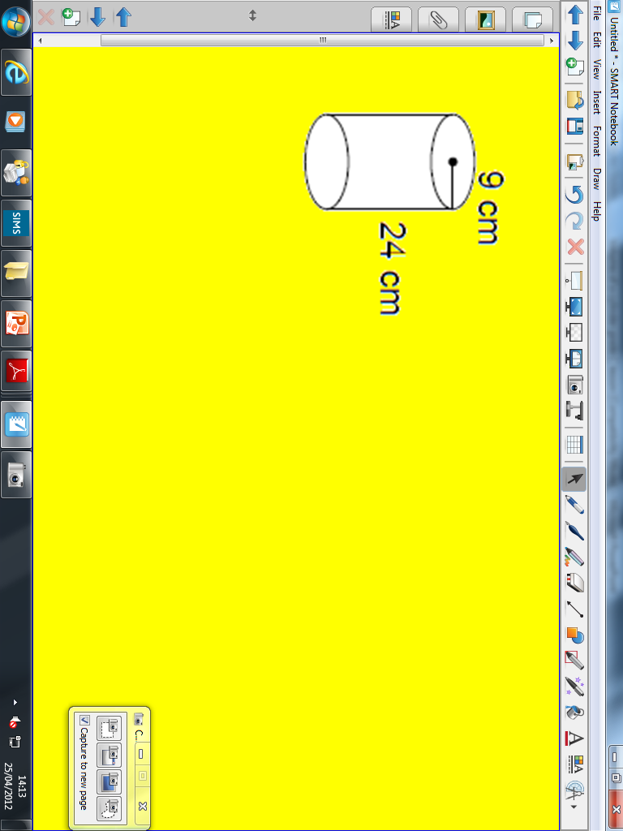



Which ones are you using?
Creative Thinker
Effective Participator
Independent Enquirer
Reflective Learner
Self Manager
Team Worker
PLT Skills
VOLUME OF CYLINDERS
TASK (GRADE C)
Calculate the volume for each of the cylinders to 2d.p. below:
1)
2)
3)
4)
5)
6)
Notes:
6

Slide 7
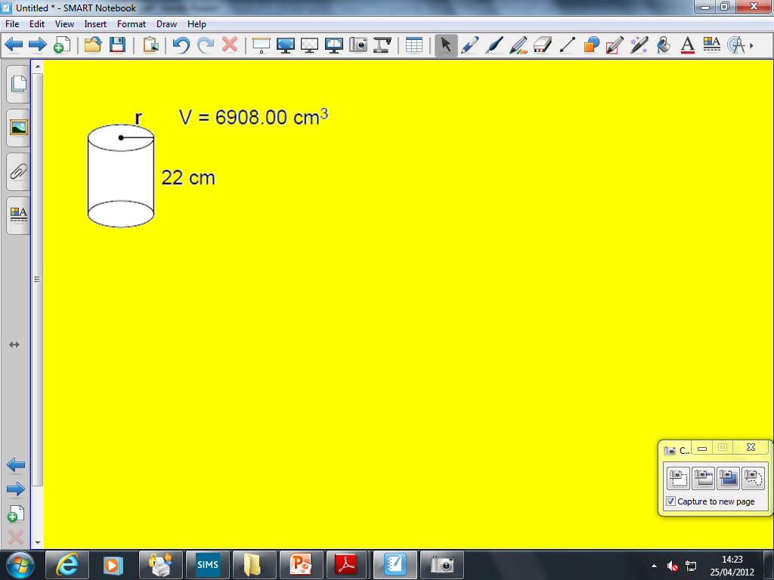
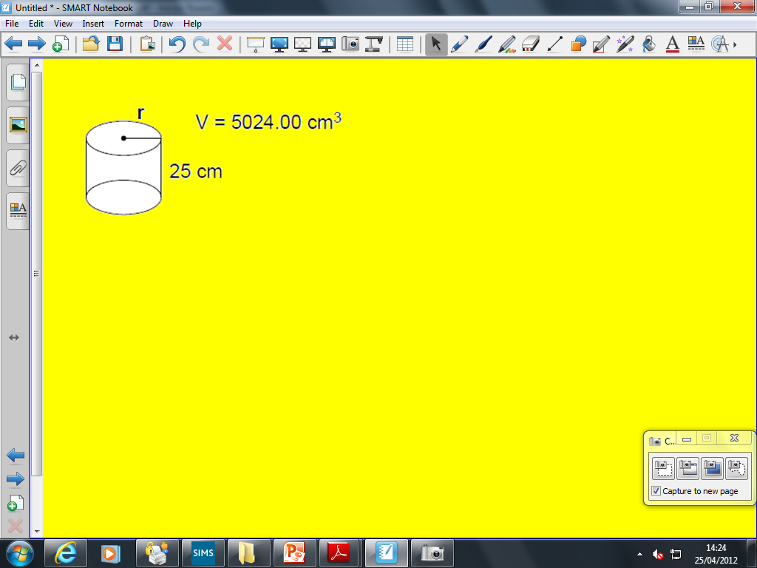
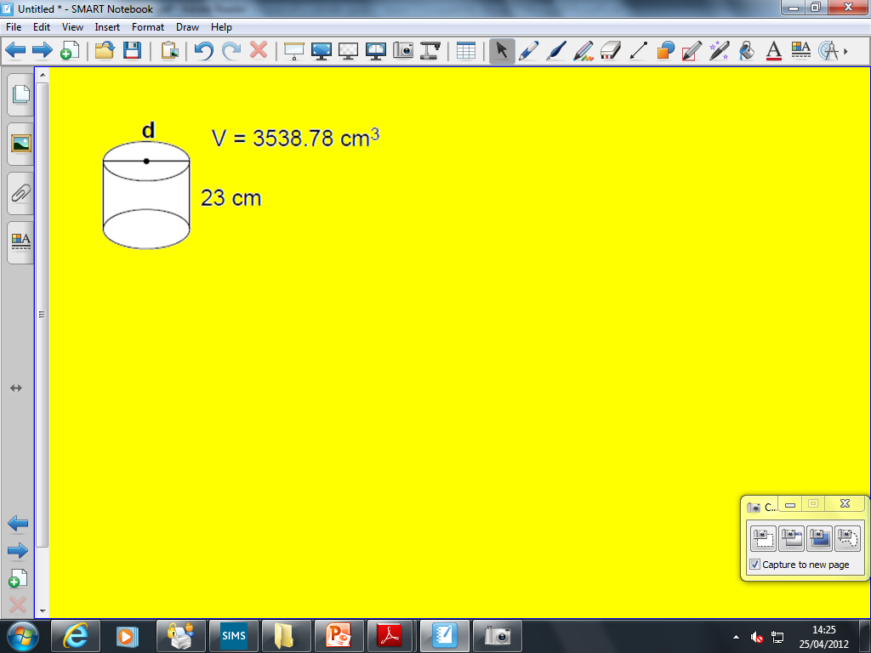

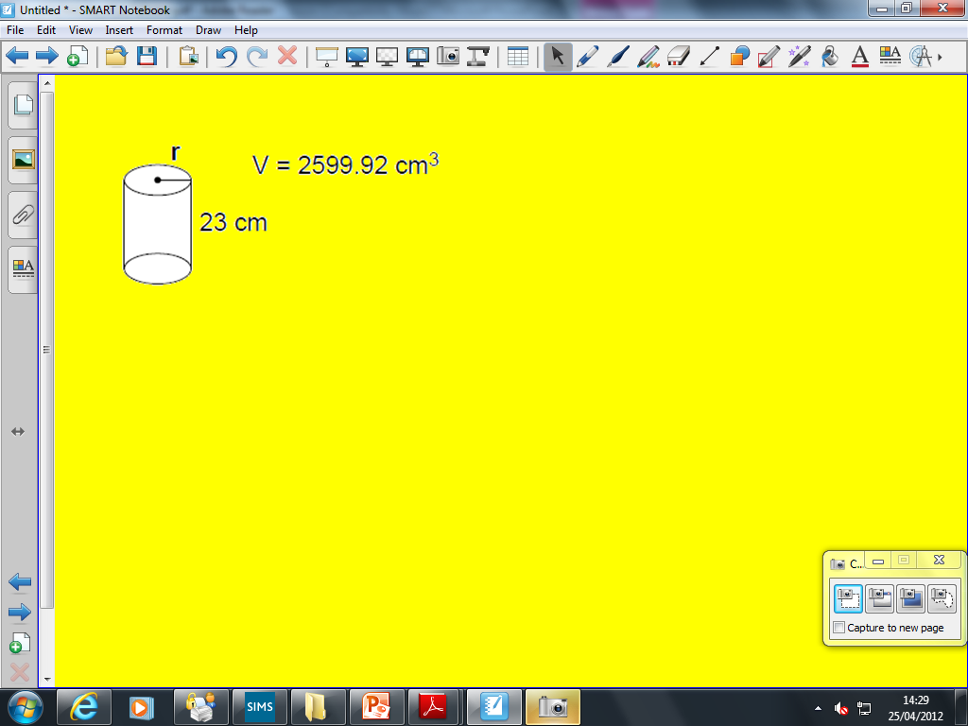
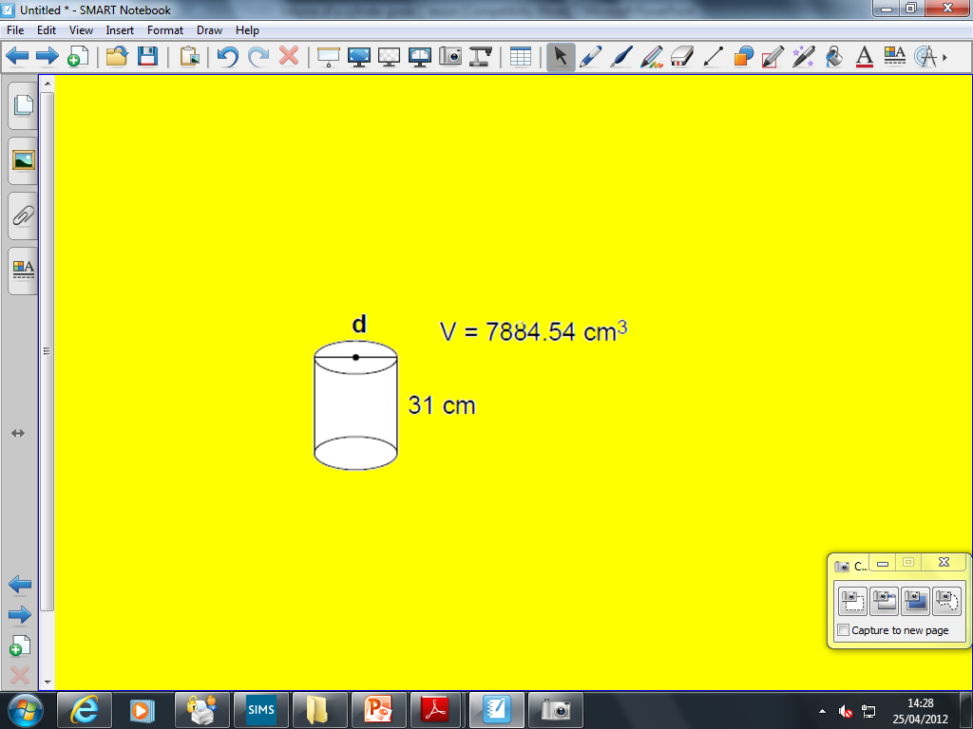
Which ones are you using?
Creative Thinker
Effective Participator
Independent Enquirer
Reflective Learner
Self Manager
Team Worker
PLT Skills
VOLUME OF CYLINDERS
EXTENSION (GRADE C)
Calculate the missing lengths for each of the cylinders below:
1)
2)
3)
r = 10cm
r = 8cm
d = 14cm
4)
5)
6)
d = 24cm
d = 18cm
r = 6cm
Notes:
7

Slide 8


Which ones are you using?
Creative Thinker
Effective Participator
Independent Enquirer
Reflective Learner
Self Manager
Team Worker
PLT Skills
VOLUME OF CYLINDERS
MINI-PLENARY
A metal bar is 1m long and has a diameter of 6cm. What is the volume of the metal bar?
METAL BAR
3cm
100cm
3
3
x
Volume of metal bar =
x
x
100
Volume of metal bar =
Notes:
8

Slide 9
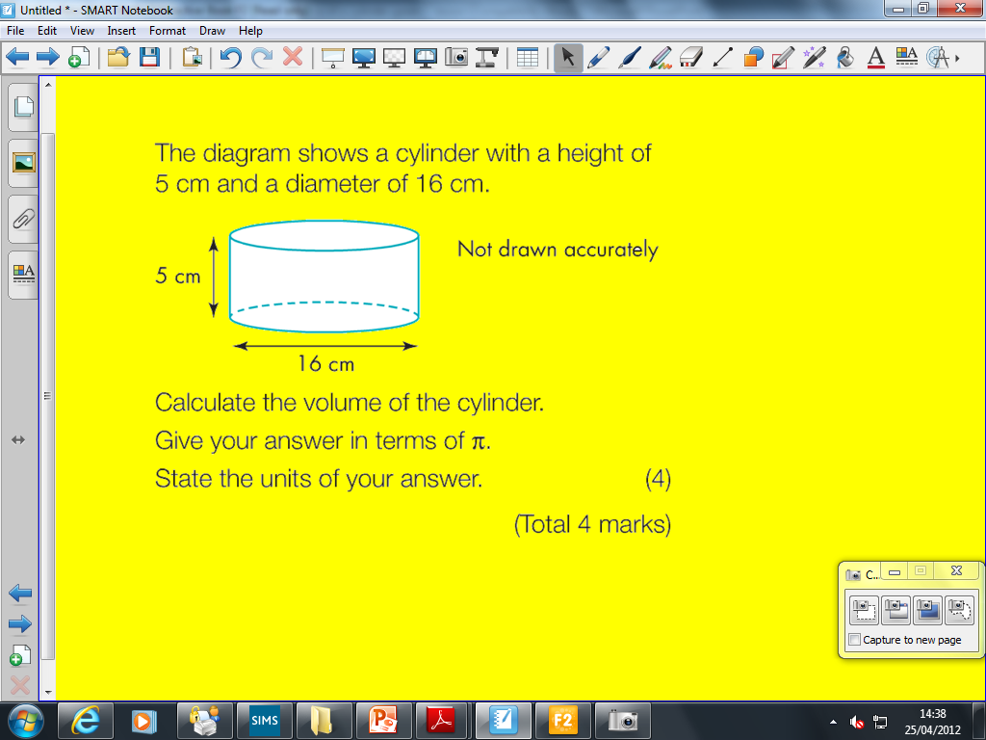


PLENARY ACTIVITY
GRADE C EXAM QUESTION (non-calculator)
x
8
x
8
x
Volume of a cylinder =
5
Volume of a cylinder =

Slide 10



Which ones are you using?
Creative Thinker
Effective Participator
Independent Enquirer
Reflective Learner
Self Manager
Team Worker
PLT Skills
How well do you understand the task?
.
I don’t understand
I nearly understand
I fully understand

Slide 11
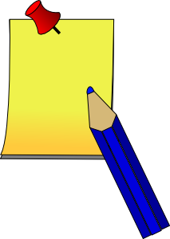

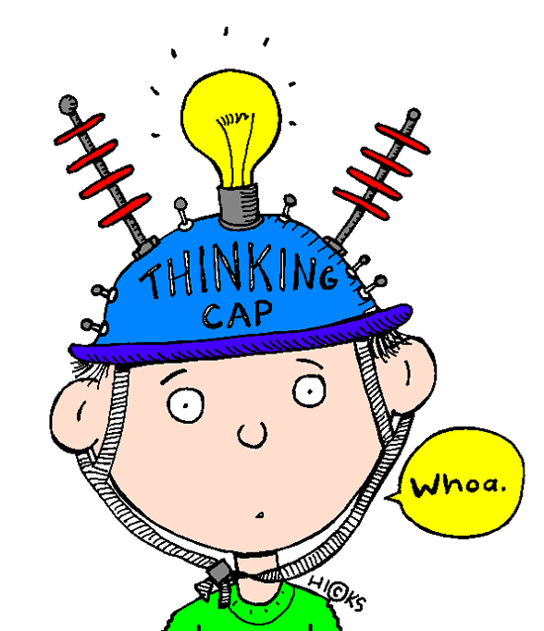
Plenary Activity
WWW (What Went Well)
EBI (Even Better If)
On your post it notes…
Think about how you can improve your work.

